Slide 1
PCB Review
Olivier Bergeron
2026/09/21

Slide 2
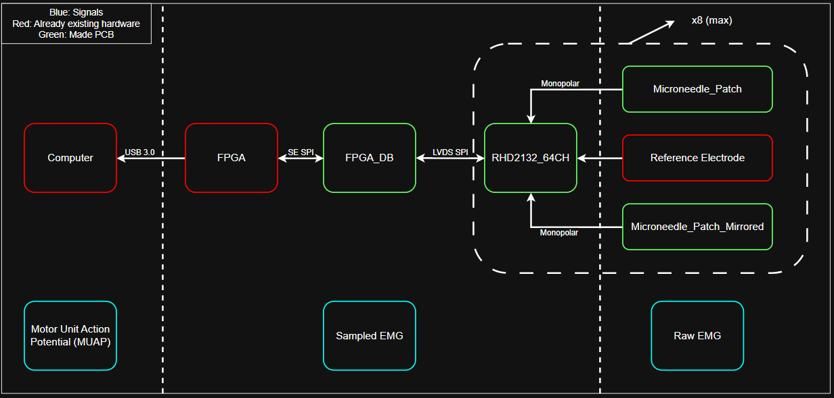

Slide 3
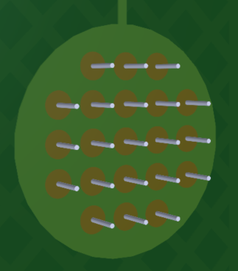
Electrode Parameters
Electrode
  2.5 mm diameter
  5 mm IED
  23 microneedle/electrode
    50 µm diameter
    400 µm long

Slide 4
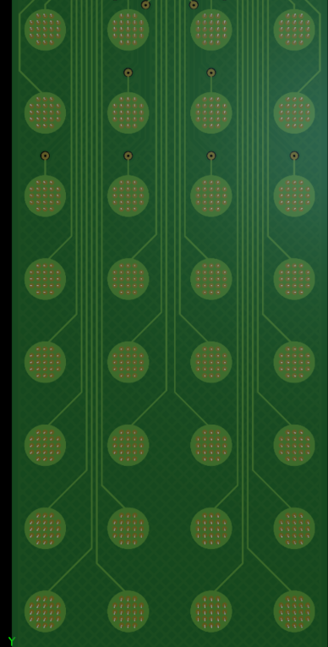
Electrode Grid
Grid size
  8 x 4
For 1 patch
  32 electrodes
  Up to 16 patches (512)
Reference electrode
  External Ag/AgCl

Slide 5
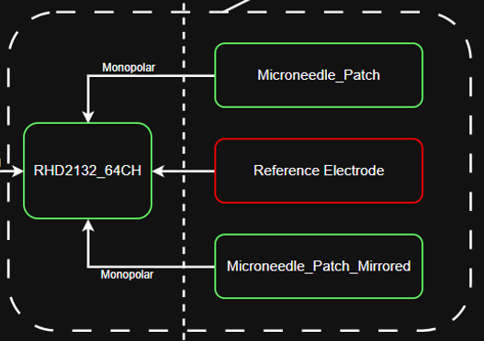
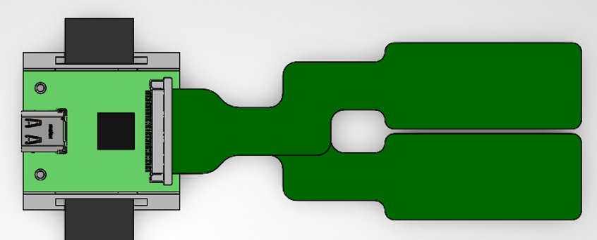
Hand
Elbow

Slide 6
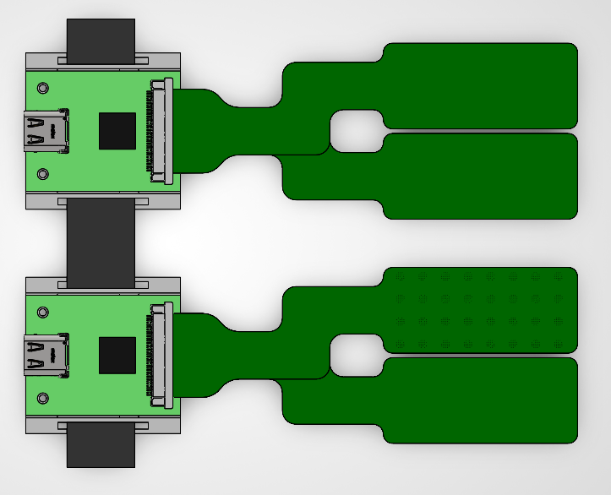
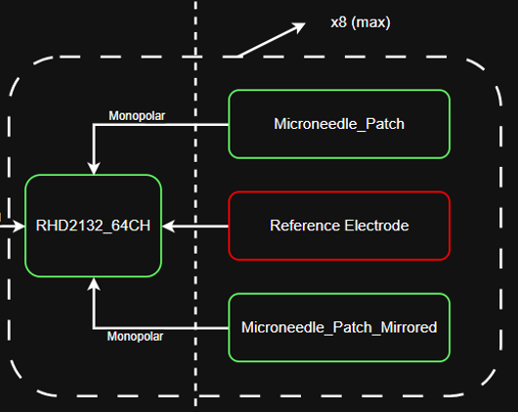
Hand
Elbow

Slide 7
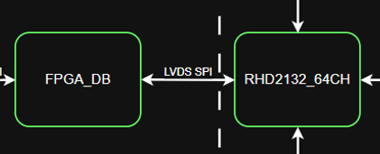
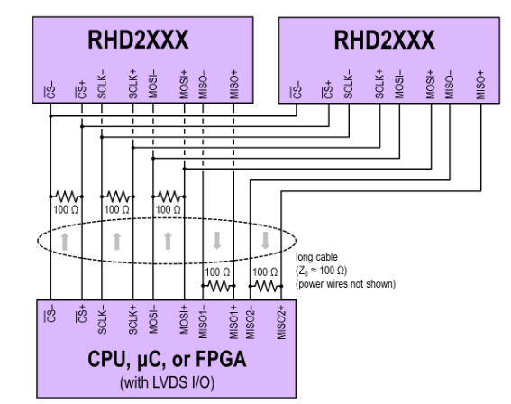
From INTAN to FPGA
For each RHD2132_64CH
  1 USB cable to FPGA board
  2x RHD2132 per board

Slide 8
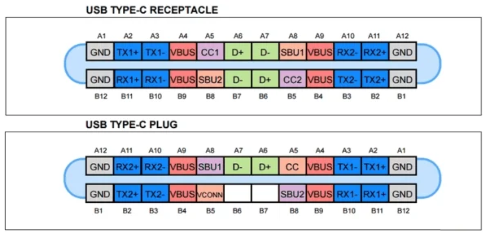
From INTAN to FPGA
5 signals to transport
  Can’t use the cable with redundancy
  Need to check polarity
Enable drivers with right polarity

Slide 9
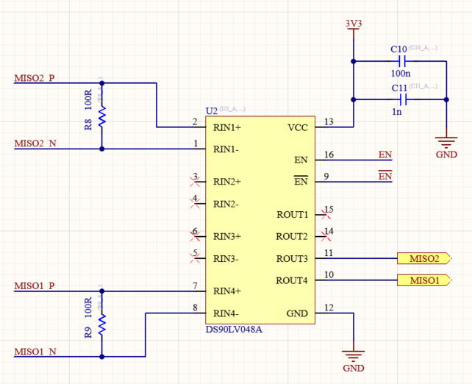
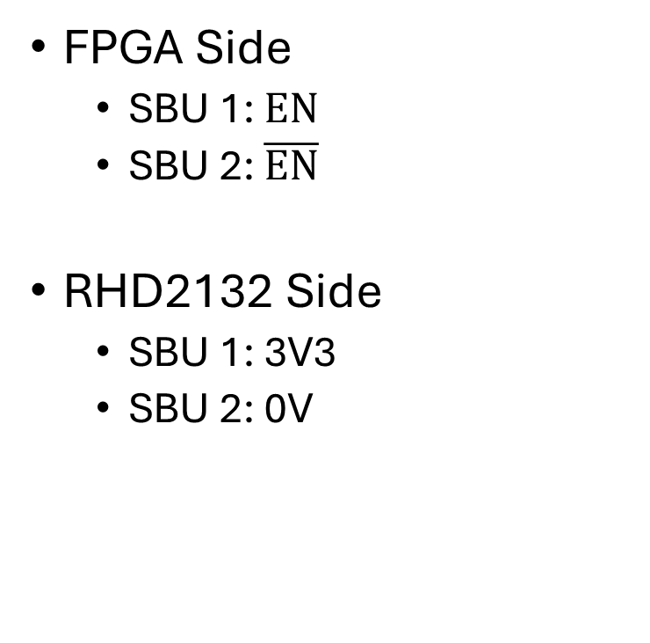
From INTAN to FPGA
FPGA Side
  SBU 1: $EN$
  SBU 2: $\overline{EN}$
RHD2132 Side
  SBU 1: 3V3
  SBU 2: 0V

Slide 10
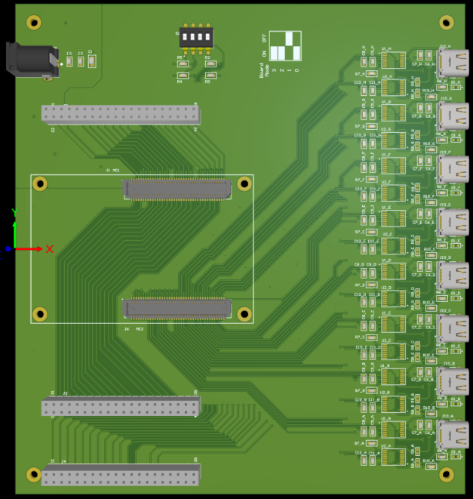
FPGA Daughter Board
USB connectors
  Connect with RHD2132
LVDS Drivers/Receivers
  FPGA: Single Ended
  RHD2132: LVDS

Slide 11
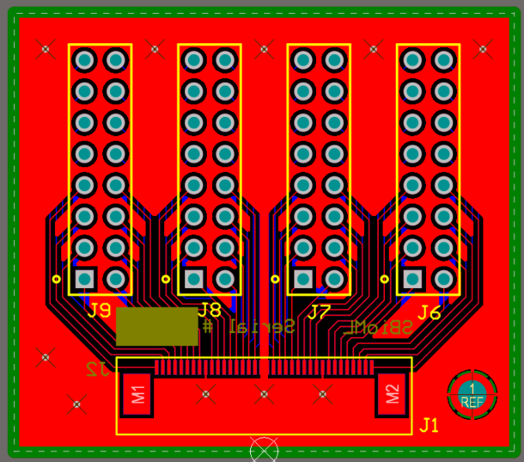
Electrode Breakout Board
For individual testing of electrode patches

Slide 12
Stackups
FPGA_DB
  Standard 4 layers PCB
  100 Ohms impedance (LVDS)
Electrode Breakout
  Standard 4 layers PCB
RHD2132_64CH
  6 layers PCB
  100 Ohms impedance (LVDS)
Electrode Patches
  2 layers FPC

